Slide 1
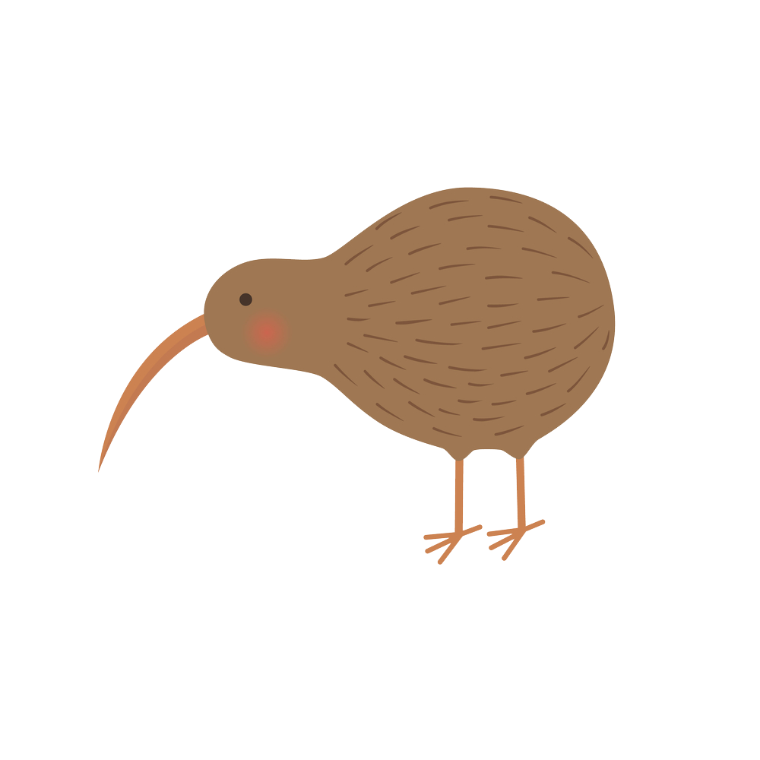
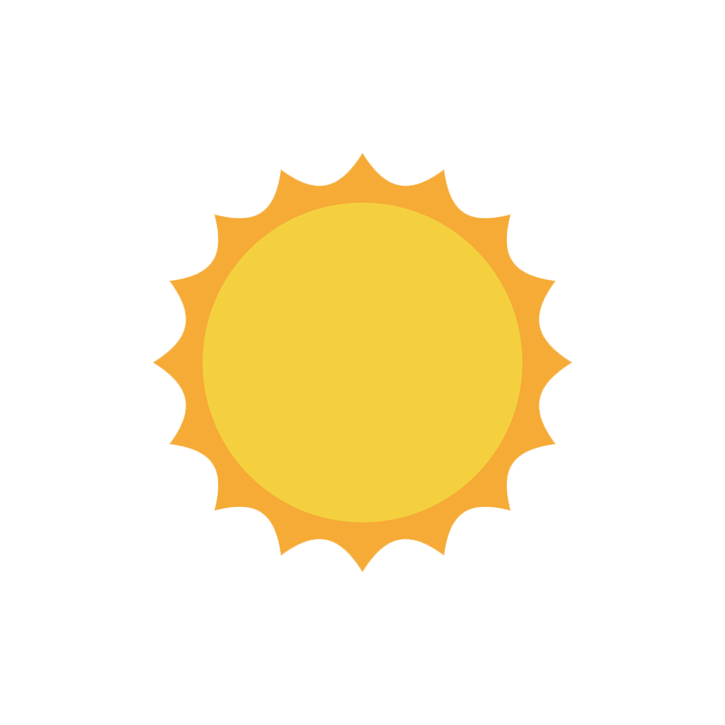
What do you know about
New Zealand

Slide 3
New Zealand
Australia

Slide 4
~270,000 km2
~36,000 km2

Slide 5
~5 mil
~24 mil

Slide 6
"maori"
New Zealand
southern island

Slide 7
8
5
3
5
3
2
New Zealand
southern island

Slide 8
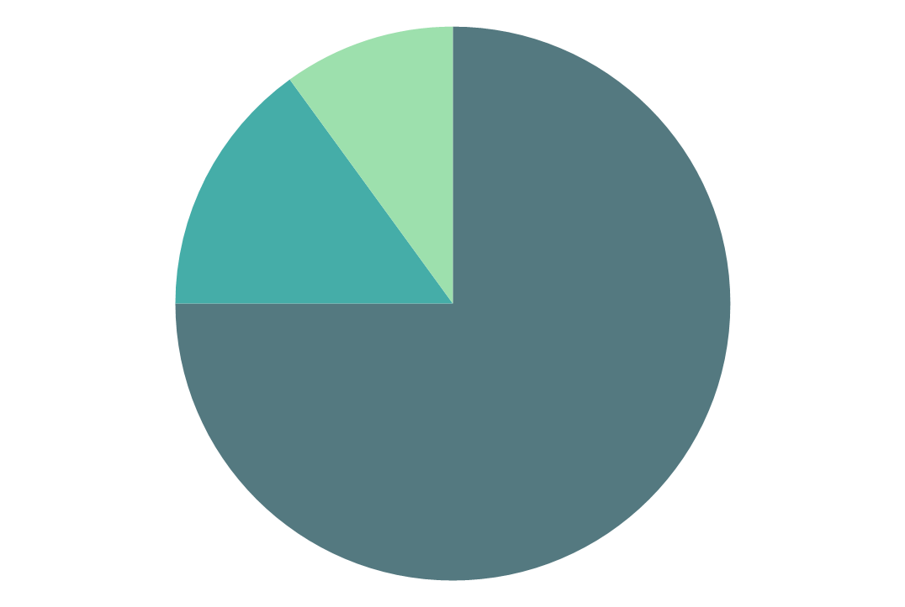
european (74%)
maori
(15%)
new zealand population
southern island

Slide 9
new zealand
southern island

Slide 10
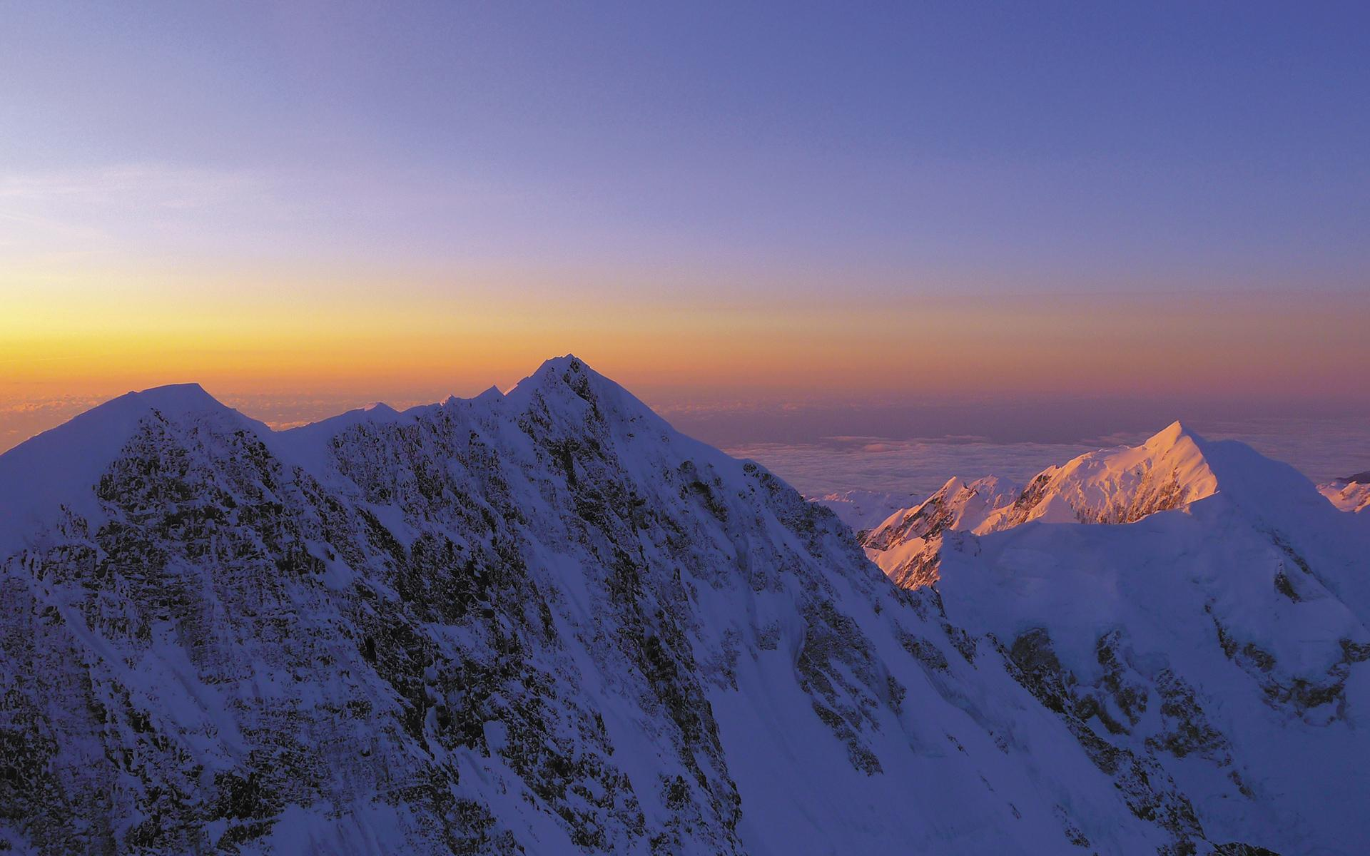
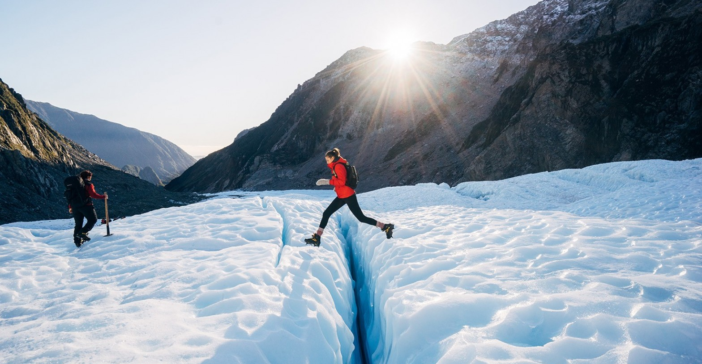
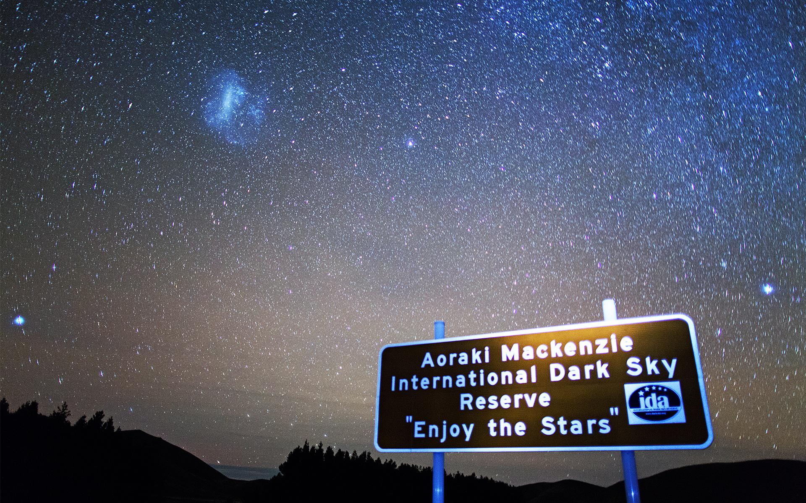
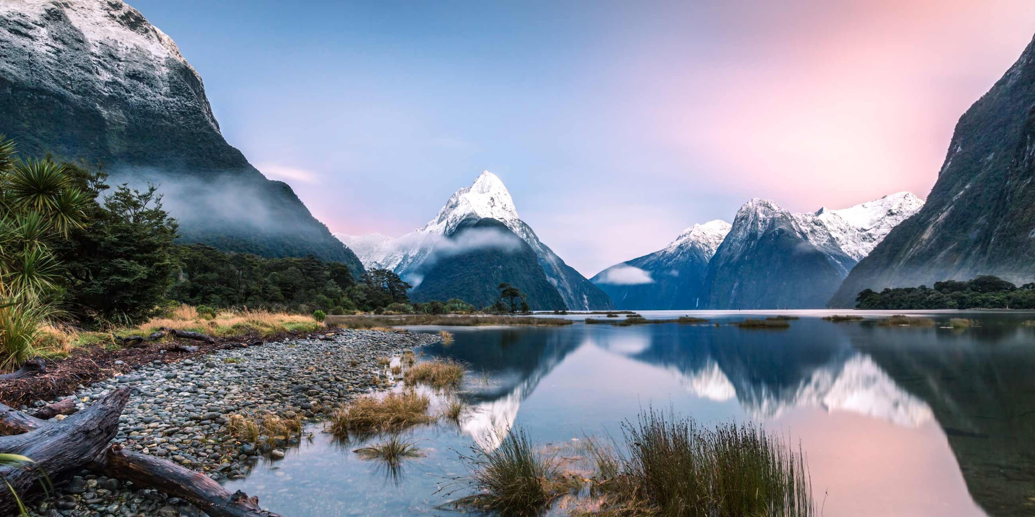
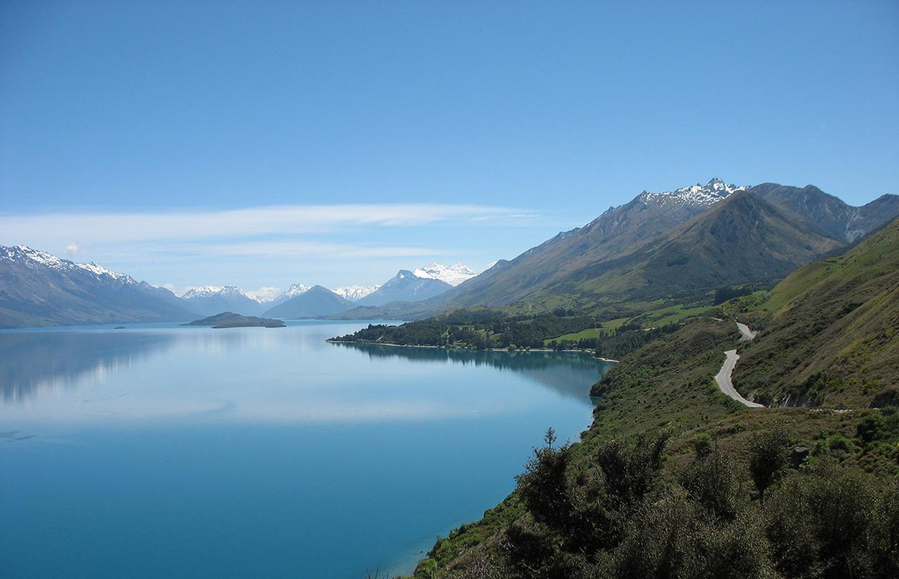
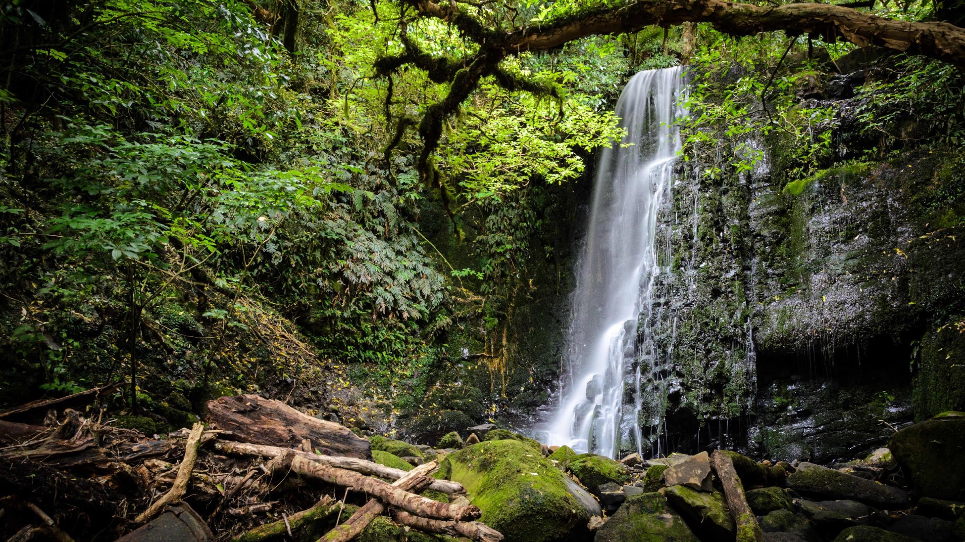
southern island
milford sound
QUEENSTOWN
new zealand

Slide 11
milford sound
mount cook
southern island
QUEENSTOWN

Slide 12
milford sound
mount cook
southern island
QUEENSTOWN
franz josef glacier

Slide 13
mount cook
southern island
QUEENSTOWN
franz josef glacier

Slide 14
northern island
southern island
milford sound
QUEENSTOWN
franz josef glacier

Slide 15
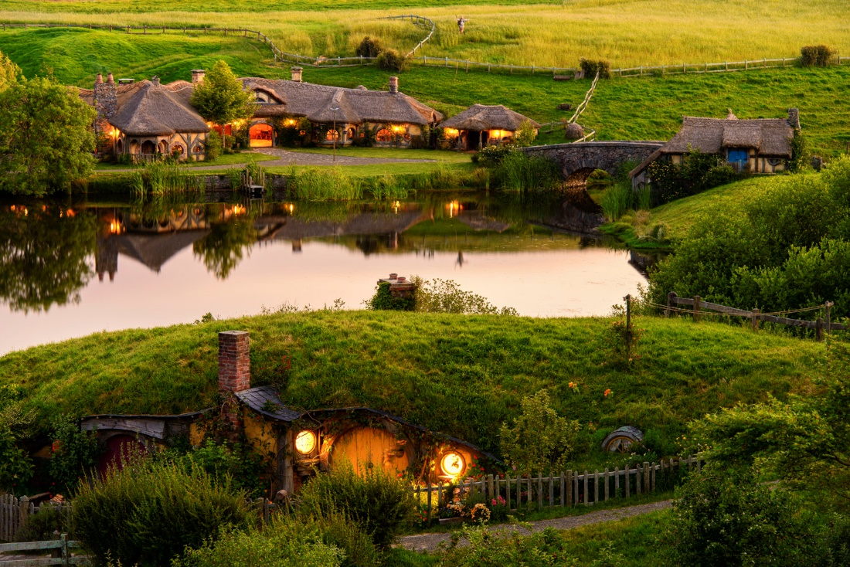
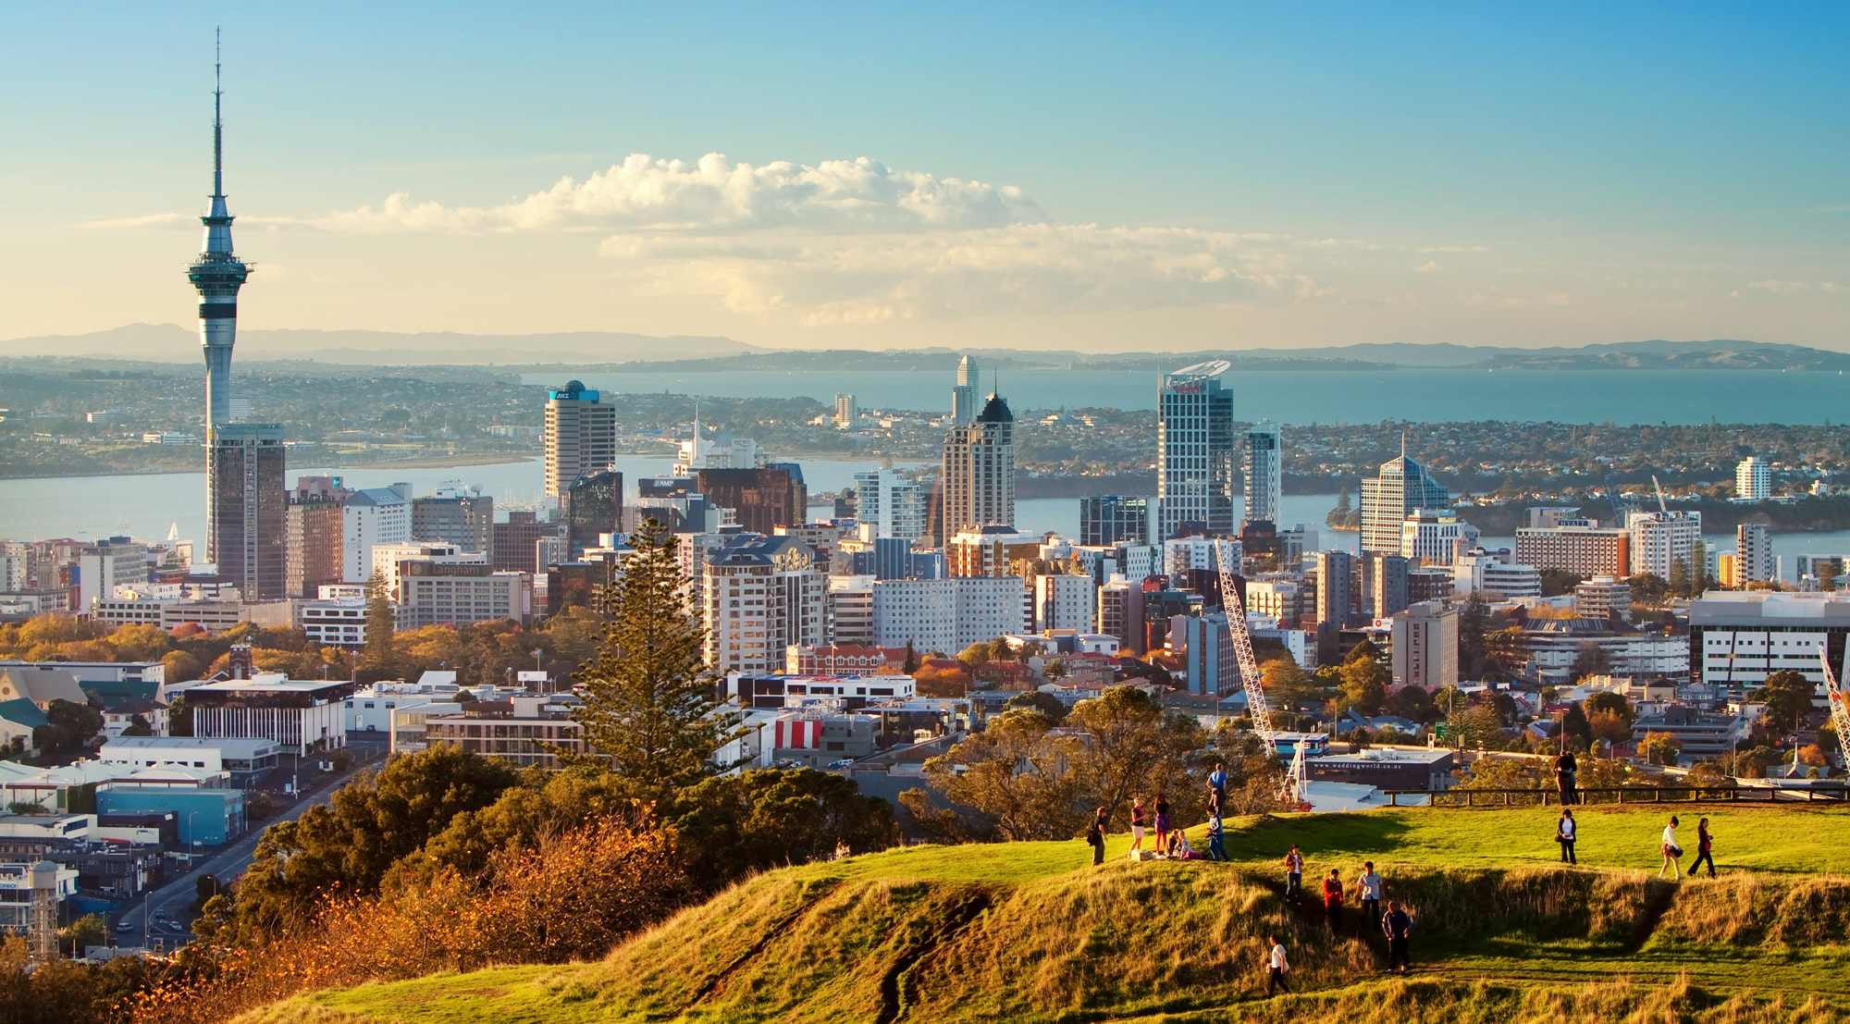
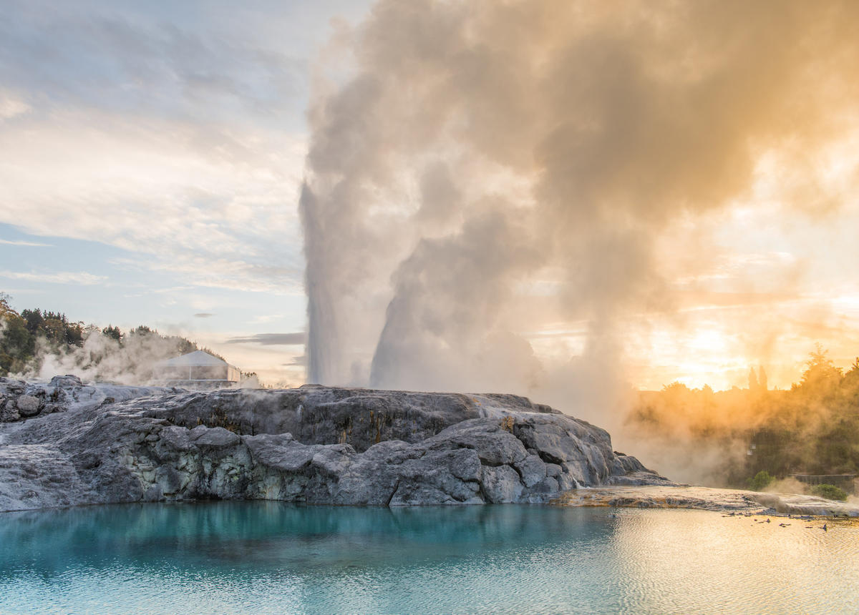
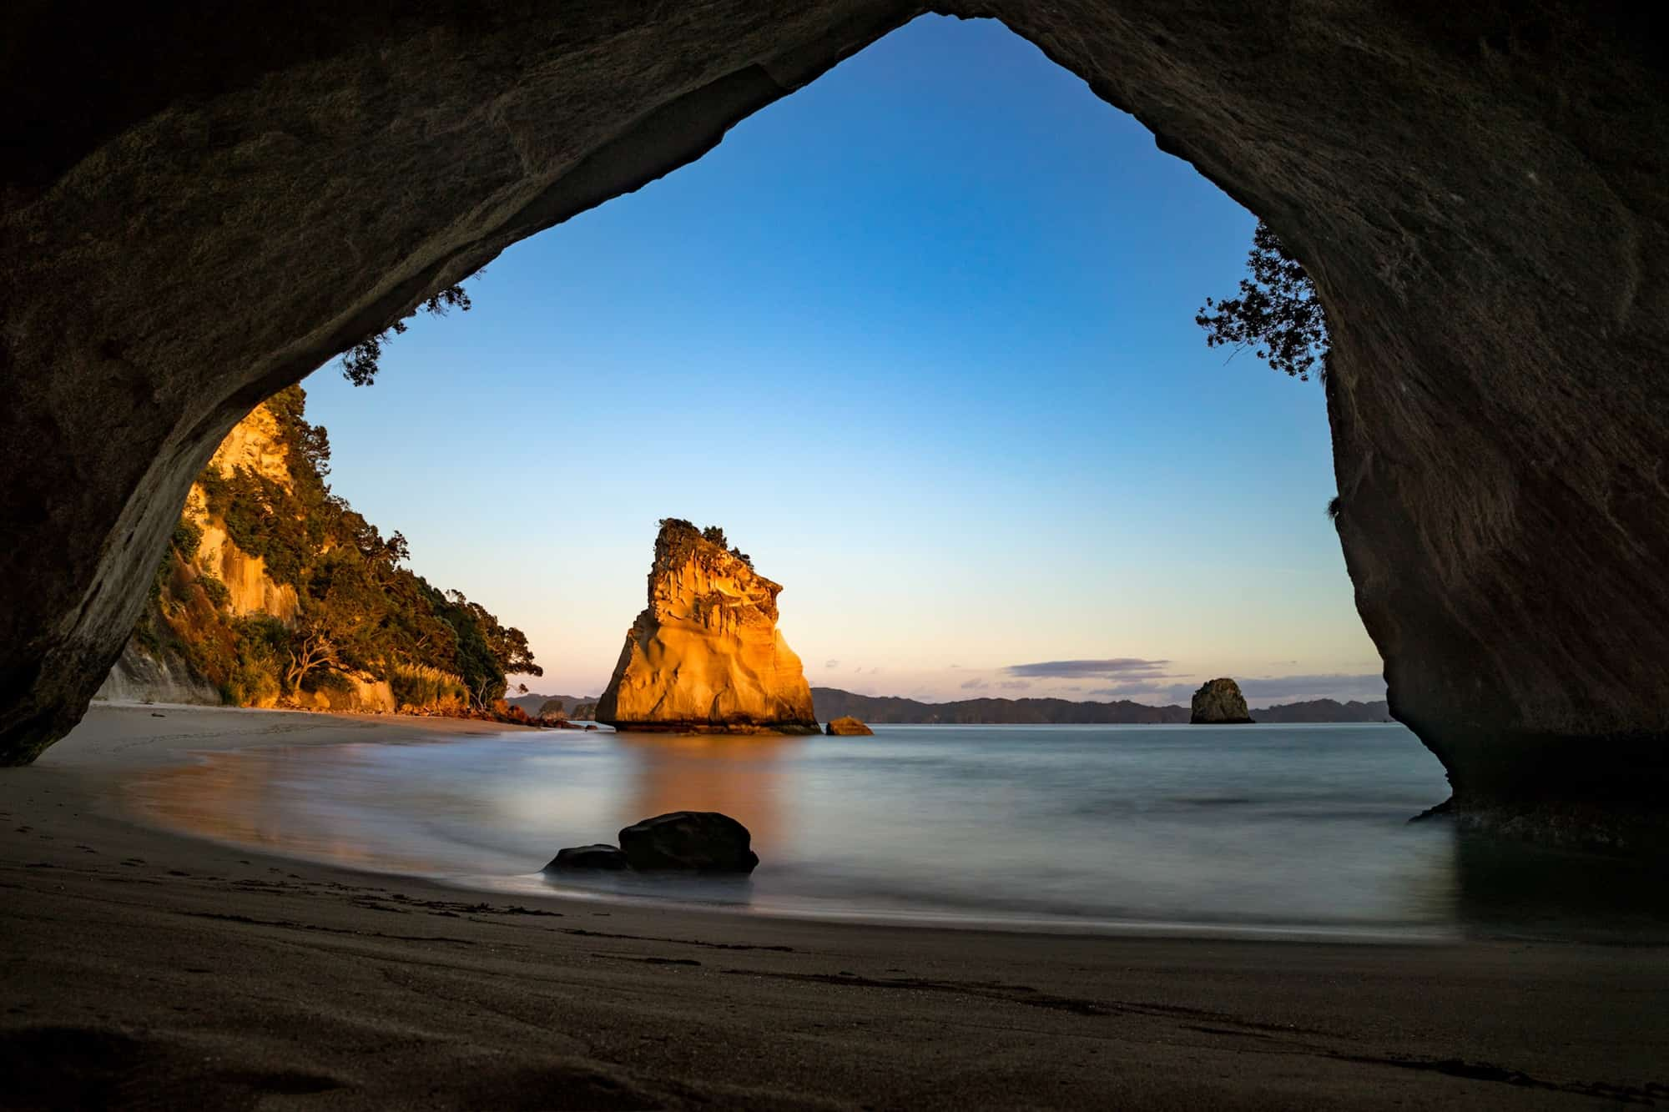
auckland
auckland
northern island
wellington
new zealand
southern island

Slide 16
auckland
northern island
auckland
cathedral cove
wellington
new zealand
southern island

Slide 17
auckland
northern island
auckland
cathedral cove
wellington
new zealand
southern island

Slide 18
rotorua - geothermal city
auckland
northern island
cathedral cove
wellington
new zealand
southern island

Slide 19
auckland
rotorua - geothermal city
northern island
auckland
cathedral cove
wellington
new zealand
southern island
hobbiton

Slide 20
rotorua - geothermal city
northern island
auckland
hobbiton
wellington
new zealand
southern island

Slide 21
kiwi bird - national symbol

Slide 24
!
!
!
!

Slide 26
kia ora!

Slide 27
=
7:1

