Slide 1
English 101
How to learn English
Fast and efficiently

Slide 2
My own experience
Didn’t have much English to begin with
Moved to Canada at age 7
Spelled everything incorrectly. EVERYTHING

Slide 3
First ever assignment
This is my family.
This is my dad.
This is my mom.
This is my sister. Her name is Ariel.
My family is from Taiwan.
Lis is my family.
Lis is my dad.
Lis is my mom.
Lis is my seester. Her name is Ariel.
My family is frum Taiwan.

Slide 4
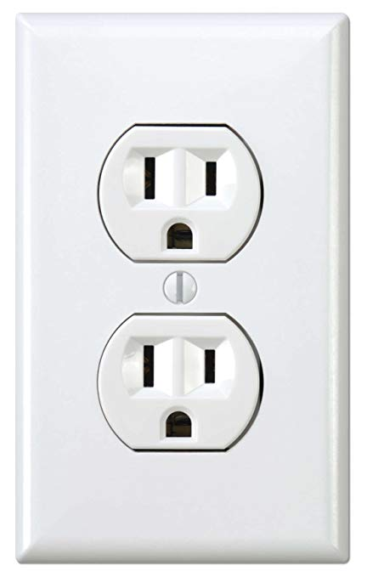
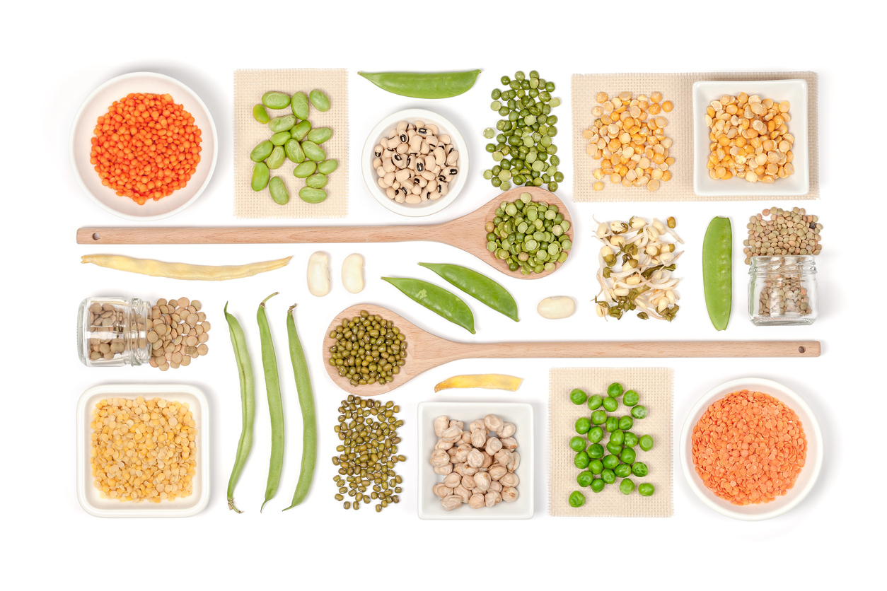
Embarrassing Moments
What is a vegetarian?
On purpose VS purposefully
Outlet (electrical)

Slide 5
ESL Classes
English as Second Language
4 years in Canada

Slide 6
So… how to get better?

Slide 7
LET’s play a game!
Charades
Pick a representative
Representative will sit at the front, facing their teammates
A word will be written on the board
Teammates will take turns describing the word on the board
The representative will try to guess the word

Slide 8
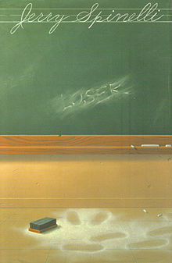
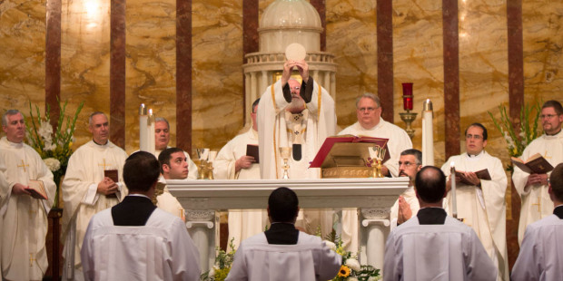
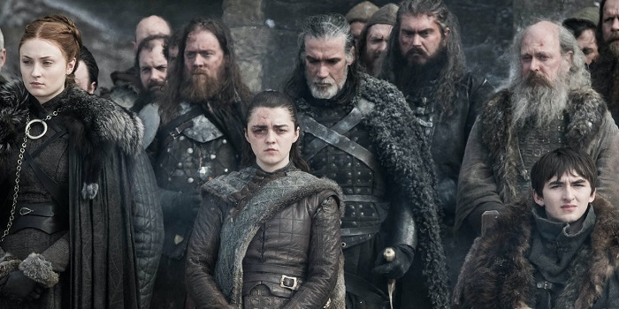
Reading
Watched TV!
Subtitles in English!
Read books
Talk about books with teachers/friends

Slide 9
Listening
TV!
With ENGLISH subtitles!
Listen to other people talking

Slide 10
Let’s play another game
Last man standing
We will choose a topic
Everyone stands up
I will throw a ball at a student
Name something related to the topic
Toss the ball at another person
Name another thing related to the topic
YOU HAVE TO BE FASTTTTT!!!!!!! 5 seconds

Slide 11
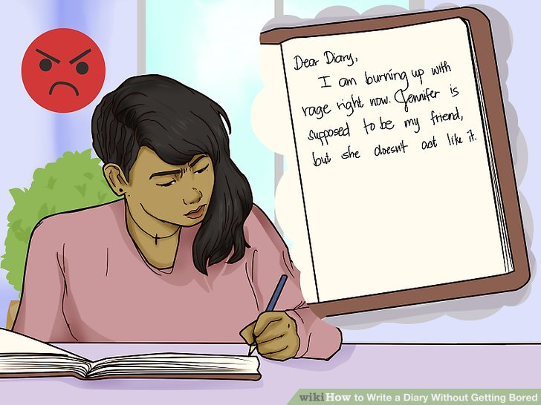
Writing
Most difficult!
Takes practice
Reading really helps!
See how other people write
Write reflections!

Slide 12
Speaking
SPEAKKKKKKKK
Use other words if stuck
Read aloud

Slide 13
Book recommendations
Holes (Louis Sachar)
Stargirl (Jerry Spinelli)
Black Beauty (Anna Sewell)
A Wrinkle in Time (Madeleine L'Engle)

Slide 14
What do you do to learn English?
Reading
Listening
Speaking
Writing

Slide 15
Tutors?
Is there a need?

Slide 16
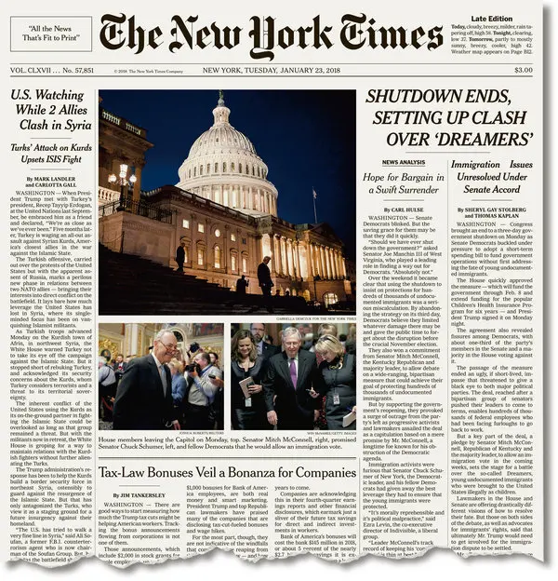
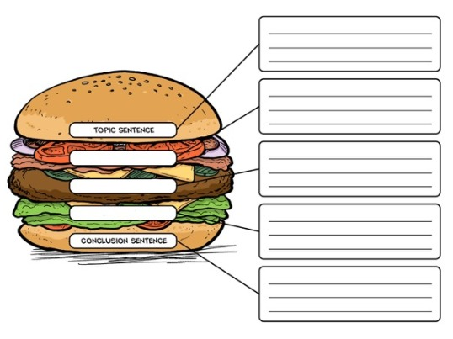
I had a tutor
From grades 4 to 6
Vocabulary, essay structure, reading comprehension
Resource for more PRACTICE

Slide 17
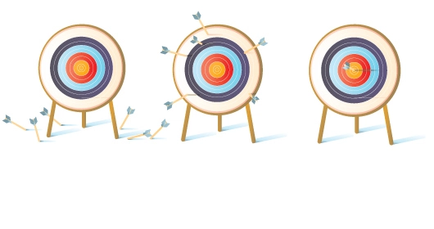
Do you need a tutor?
NO
Tutor is only for practice (someone to tell you what’s wrong/right)
Can find other resources
Online
Library

Slide 18
After all…
You will never learn unless you want to
You will never learn if you don’t try

Slide 19
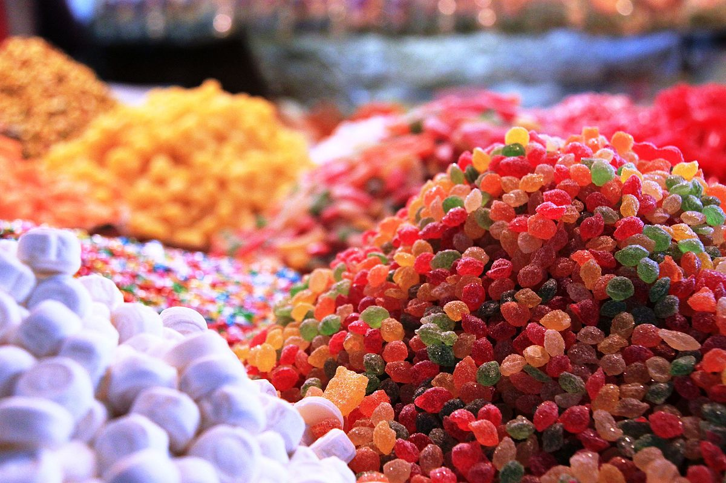
Which is why
The people who really listened and participated today get a REWARD
You reap what you sow!

